Slide 1


www.tarahtech.com

Slide 2

SQL:
SQL (Structured Query Language) is a standardized programming language used for managing relational databases and performing various operations on the data .
It is a computer language for storing, manipulating and retrieving data stored in a relational database.
SQL is the standard language for Relational Database System.
All the Relational Database Management Systems (RDMS) like MySQL, MS Access, Oracle, Sybase, Informix, Postgres and SQL Server use SQL as their standard database language.

Slide 3
SQL commands:
Standard SQL commands interact with relational databases. The commands are.
  Select
  Where
  And,or,not
  Order by
  Null values
  Delete
  Update
  Min and Max
  Group by
  Jion
  Union
  Between

Slide 4
SQL queries in Pandas:
Usage of following SQL commands in Pandas.
SELECT:
The SELECT statement is used to select data from a database.This command is used select specific columns and rows in a data.
SELECT DISTINCT:
The SELECT DISTINCT statement is used to return only distinct (different) values.
Inside a table, a column contains many duplicate values and sometimes to list the distinct values.
WHERE:
The WHERE clause is used to filter records.
It extracts only some records that fulfill the specific conditions.

Slide 5
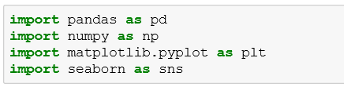
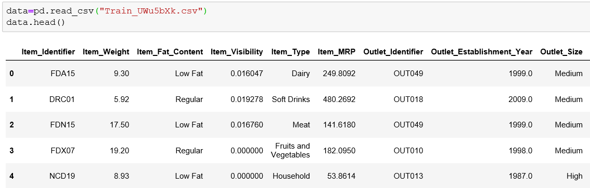
Implementing SQL commands in Python:
Importing libraries.
Read the csv file.

Slide 6
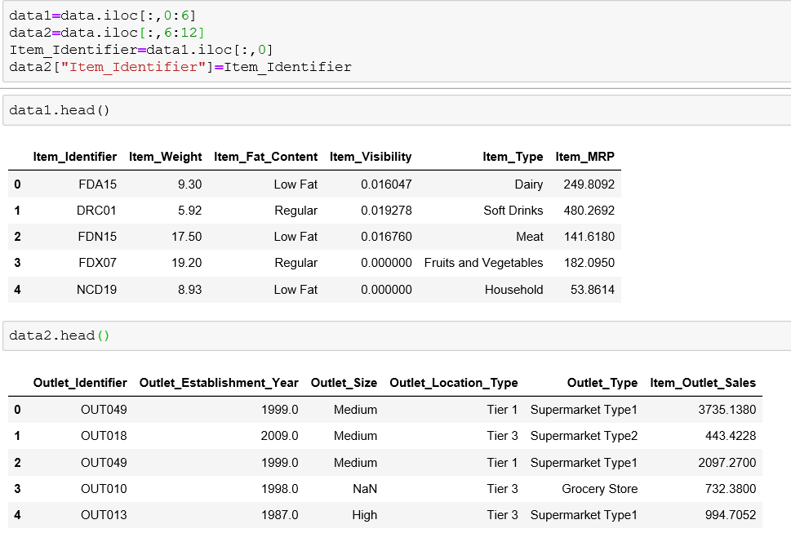
Divide the csv file into two tables.

Slide 7
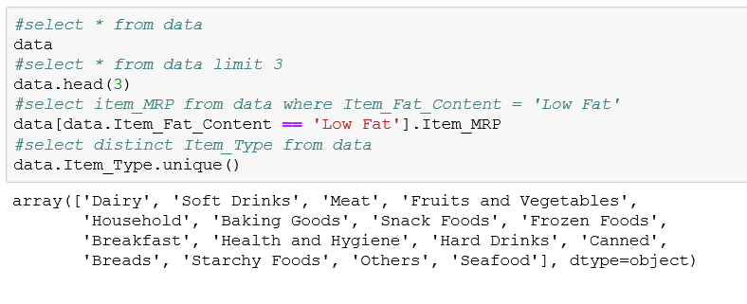
SELECT, WHERE, DISTINCT, LIMIT:

Slide 8
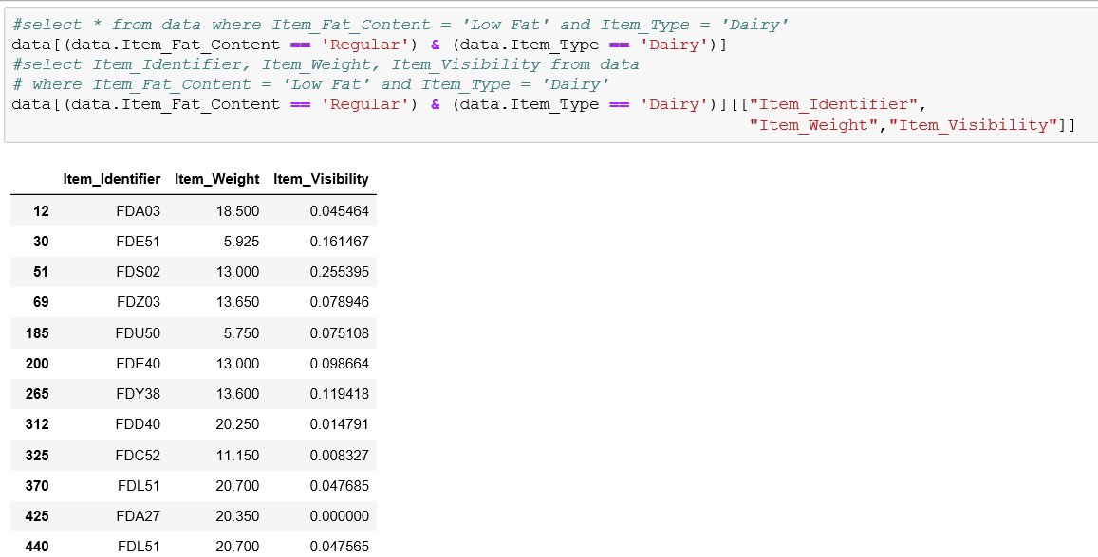
SELECT with multiple conditions:

Slide 9
ORDER BY:
The ORDER BY keyword is used to sort the data in ascending or descending order. By default it takes Ascending order.
IN:
The IN operator is used to specify the multiple values in a WHERE clause.
The IN operator is shorthand for multiple OR conditions.
GROUP BY:
The GROUP BY statement is used with aggregate functions (COUNT, MAX, MIN, SUM, AVG) to group the result-set by one or more columns.
COUNT:
The COUNT function returns the number of rows that matches the specified criteria.

Slide 10
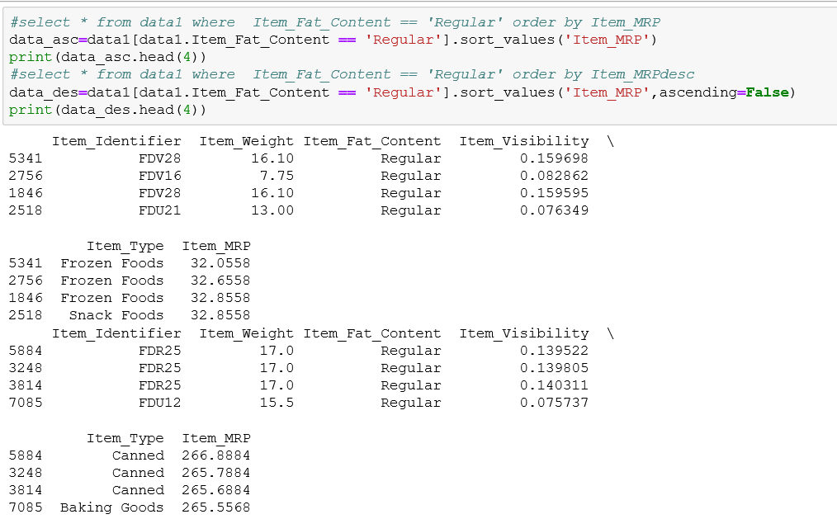
ORDER BY:

Slide 11
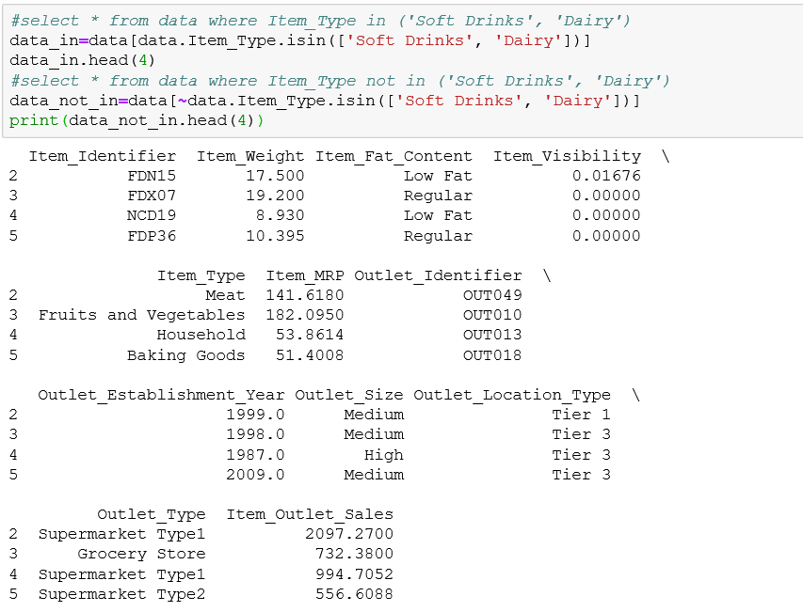
IN… NOT IN:

Slide 12
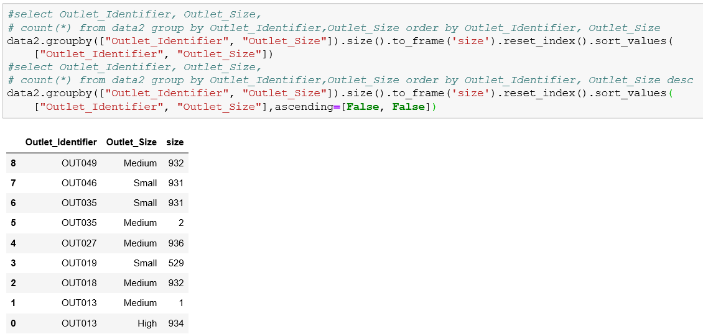
GROUP BY, COUNT, ORDER BY:

Slide 13
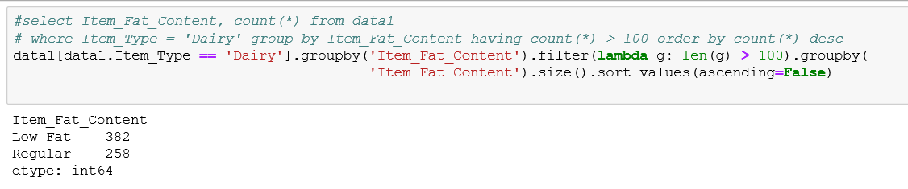
HAVING:
The HAVING condition was added to SQL because the WHERE keyword could not be used with aggregate functions.
The HAVING condition is used for to filter grouped data.

Slide 14
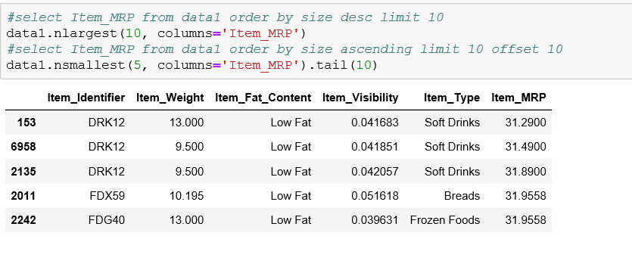
First Few(N) Records:

Slide 15
Aggregate functions:
MIN:
  The MIN() function returns the smallest value of the selected column.
MAX:
  The MAX() function returns the largest value of the selected column.
MEAN:
  The AVG() function returns the average value of a numeric column.

Slide 16
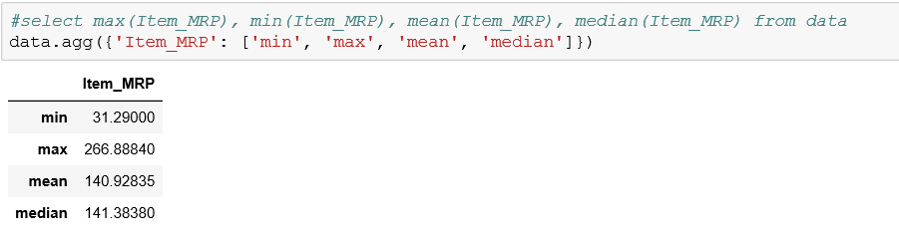
Aggregate functions (MIN, MAX, MEAN):

Slide 17
JOIN:
A JOIN function is used to combine rows from two or more tables, based on a related column.
IN SQL we different types of joins.
  INNER JOIN
  LEFT JOIN
  RIGHT JOIN
  FULL JOIN
INNER JOIN:
Returns records that have matching values in both tables.
LEFT JOIN:
Return all records from the left table, and the matched records from the right table.
RIGHT JOIN:
Return all records from the right table, and the matched records from the left table.
FULL JOIN:
Return all records when there is a match in either left or right table.

Slide 18
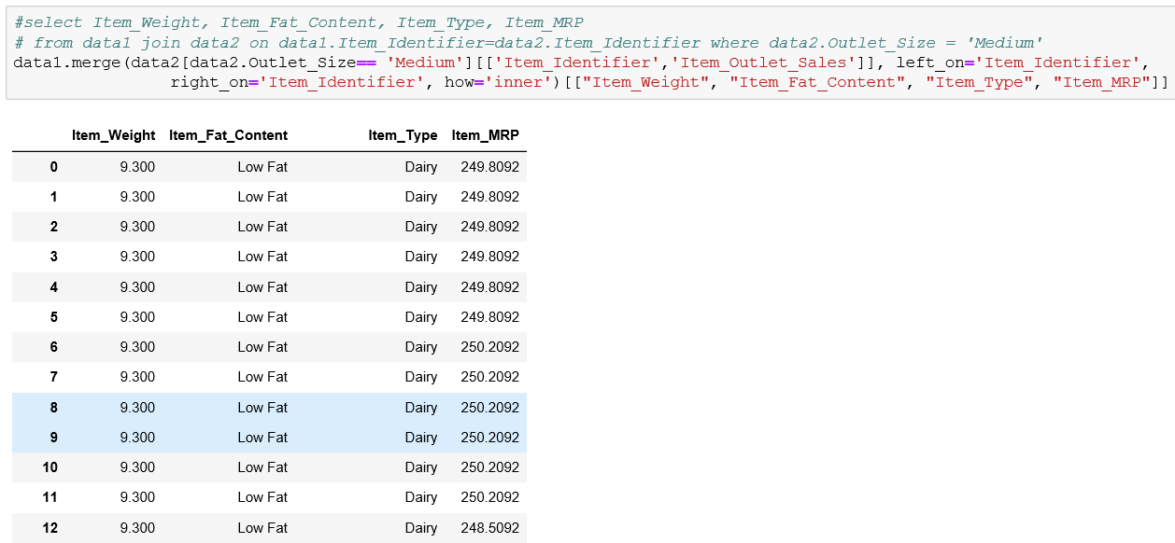
JOIN:

Slide 19
UNION:
The SQL UNION clause is used to combine the results of two or more SELECT statements without returning any duplicate rows.
To use this UNION clause, each SELECT statement must have
  Same number of columns selected
  Same number of column expressions
  Same data type and
  Same order
INSERT INTO:
The SQL INSERT INTO Statement is used to add new rows of data to a table.
To write the INSERT INTO statement in two ways.
  The first way specifies both the column names and the values to be inserted:
  Adding values for all the columns of the table, do not need to specify the column names in the SQL query. However, make sure the order of the values is in the same order as the columns in the table.

Slide 20
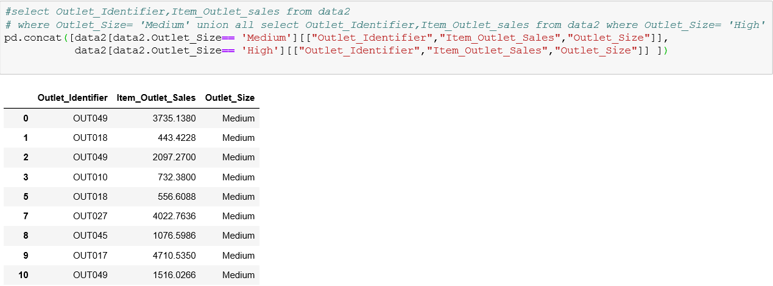
UNION ALL and UNION:

Slide 21
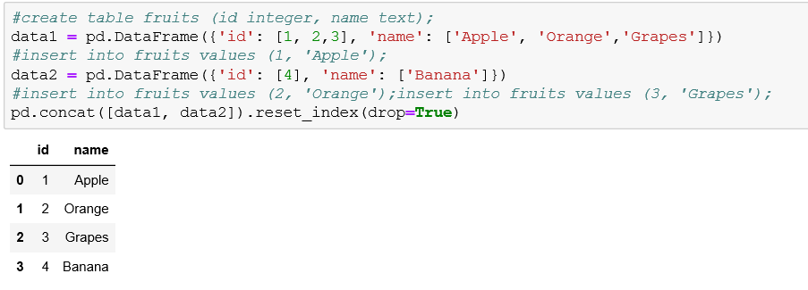
Insert in Sql:

Slide 22
Summary:
In this slide show we covered SQL commands in pandas.which are
  SELECT, WHERE, DISTINCT, LIMIT
  SELECT with multiple conditions
  ORDER BY
  IN… NOT IN
  GROUP BY, COUNT, ORDER BY
  HAVING
  Aggregate functions
  JOIN
  UNION ALL and UNION
  INSERT

Slide 23

Thank You

